Slide 1
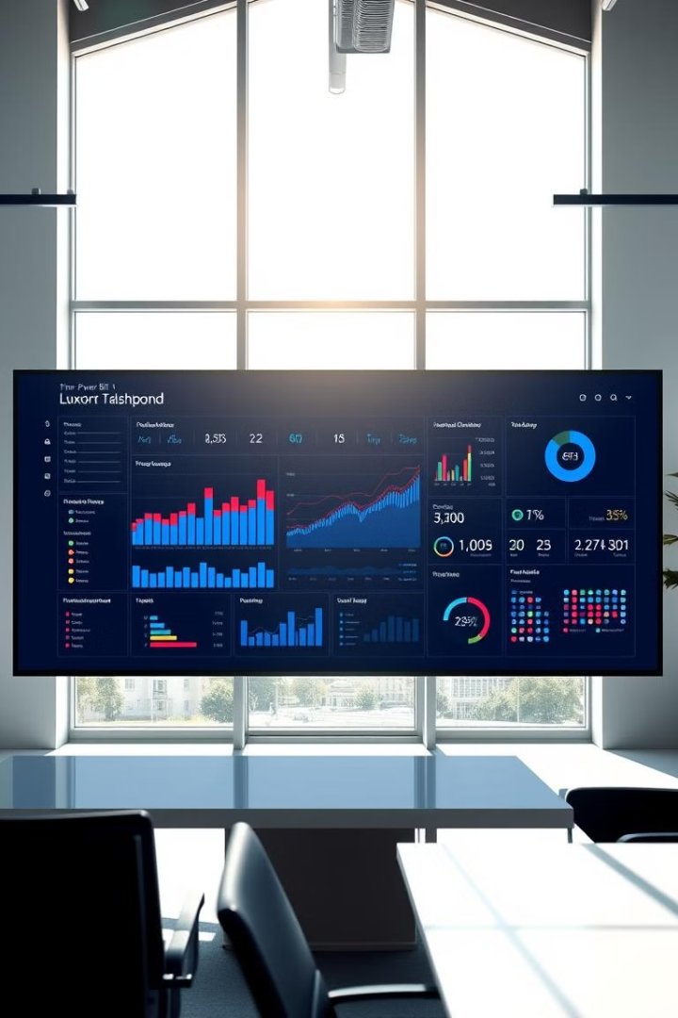
Company Data Analysis by Power BI
Power BI offers a comprehensive solution for analyzing and visualizing company data. It empowers businesses to gain valuable insights, make informed decisions, and drive growth.

Slide 2

Introduction to Power BI
1
Data Exploration
2
Data Storytelling
3
Data Insights
Power BI allows you to explore and understand your data in intuitive ways. You can easily create interactive charts and dashboards to uncover hidden patterns.
Power BI helps communicate insights effectively by creating visually appealing reports and dashboards. You can share your findings with colleagues and stakeholders.
It enables you to uncover trends, identify opportunities, and make data-driven decisions that impact your business.

Slide 3
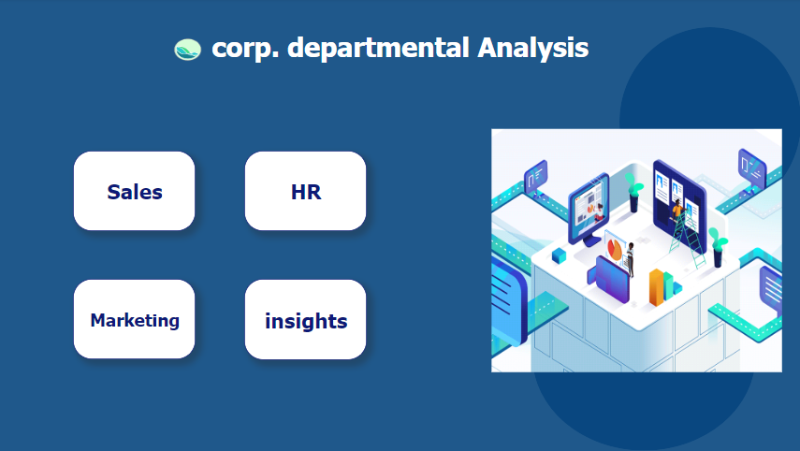

Slide 4
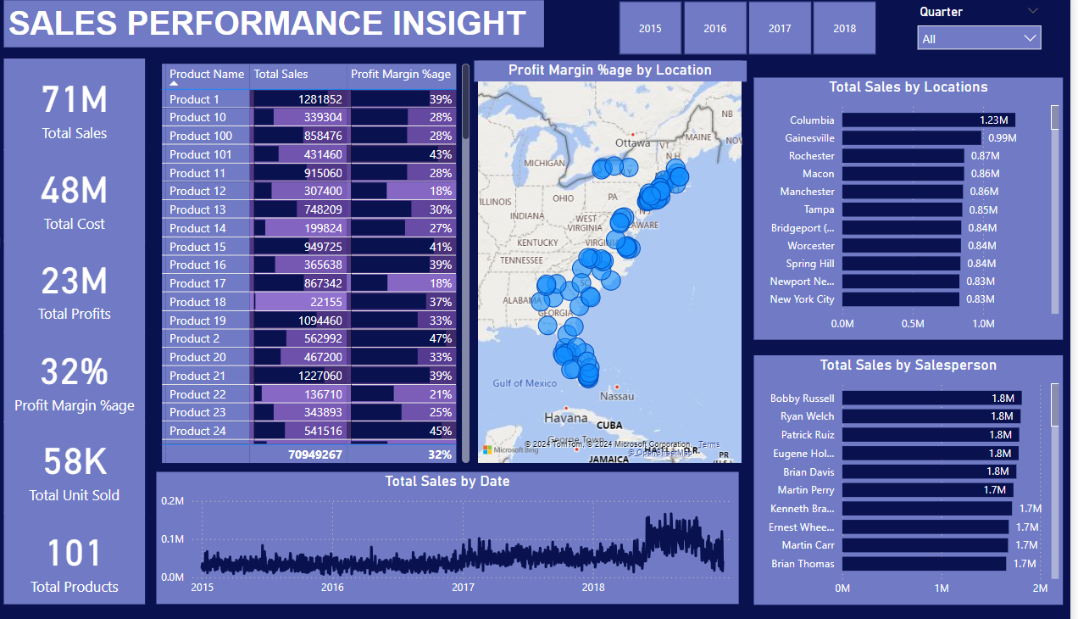

Slide 5
SALES PERFORMANCE INSIGHT
Total Sales and Performance:
Total sales amount to 71M.
Total cost stands at 48M, with a total profit of 23M.
The overall profit margin percentage is 32%.
Product-wise Performance:
The top-performing product is Product 1, with sales of 1.28M and a profit margin of 39%.
Other notable products include Product 100 (858K sales, 26% margin) and Product 21 (1.22M sales, 39% margin).
Some products have lower sales but higher margins, such as Product 101 with a 43% margin on 431K sales
Location-based Sales Insights:
The highest sales location is Columbia with 1.23M sales.
Other strong locations include Gainesville (0.99M), Rochester (0.87M), and Macon (0.86M).
Sales appear concentrated across locations in the eastern United States, as shown in the map visualization.
Sales by Salesperson:
The leading salespersons include Bobby Russell, Ryan Welch, Patrick Ruiz, and Eugene Holmes, each with approximately 1.8M in sales.
Brian Davis and Martin Perry also perform well with 1.8M and 1.7M in sales, respectively.
Trend Analysis:
The line graph showing total sales by date reveals fluctuations over time, with notable peaks in 2016 and gradual increases in sales toward the end of 2018.

Slide 6
SALES PERFORMANCE INSIGHT
Important Insights:
Top Products: Focus on Product 1 and Product 21, which drive substantial revenue.
Key Locations: Columbia, Gainesville, and Rochester are significant contributors to the sales volume.
Top Performers: Bobby Russell, Ryan Welch, and Patrick Ruiz lead the sales efforts, making them crucial to overall company performance.
Profit Margins: Margins vary by product and location, highlighting the need to optimize for profitability in underperforming areas or products.

Slide 7
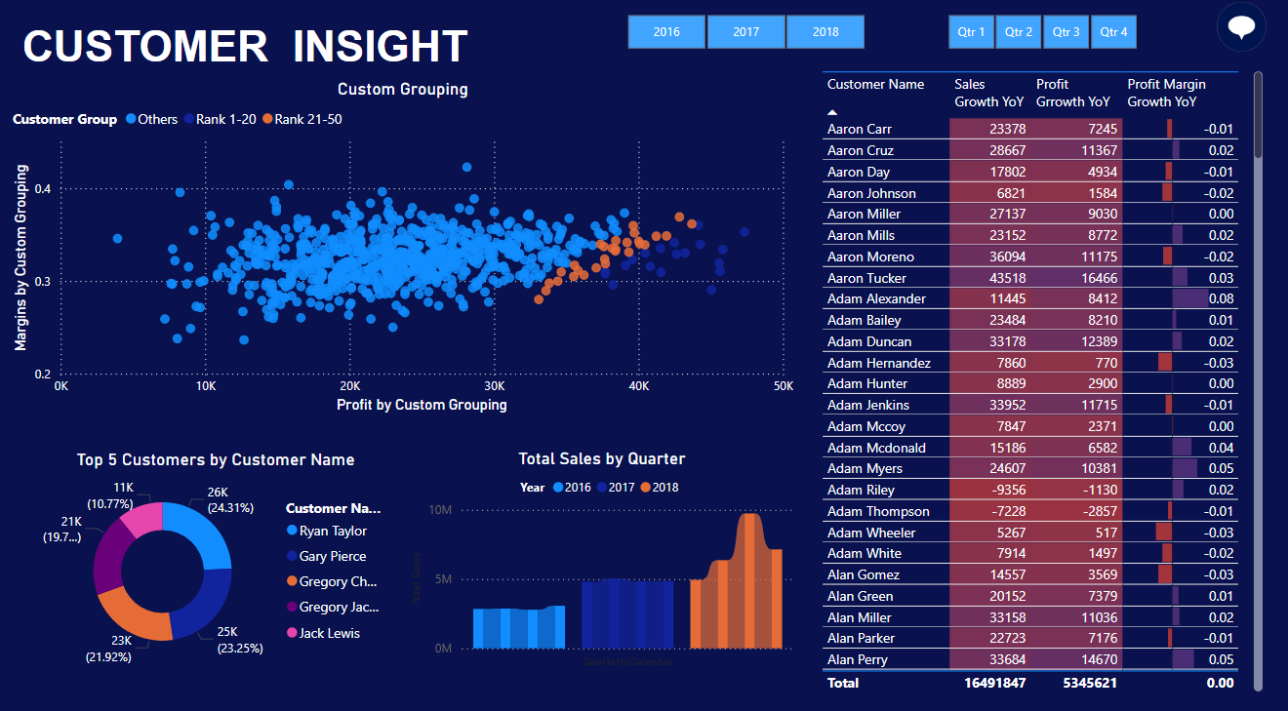
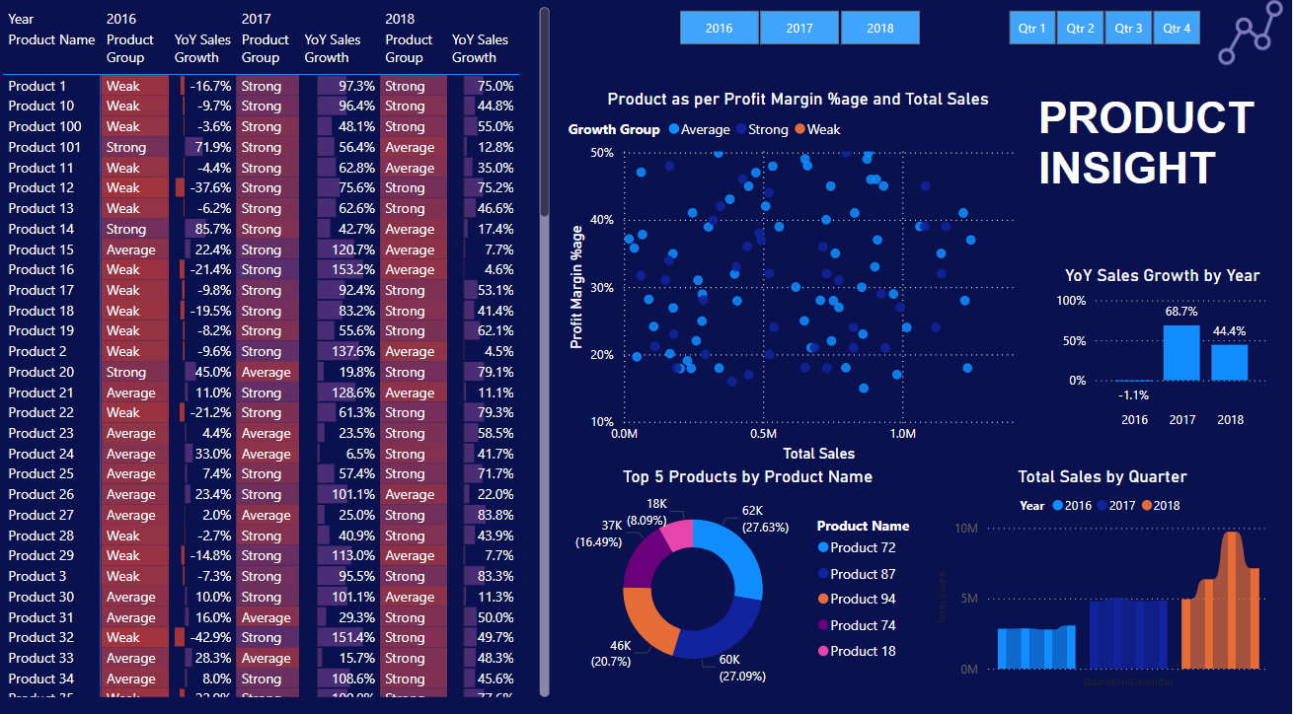

Slide 8
Customer Insight
Customer Grouping Analysis:
The scatter plot shows customer groups, with Rank 1-20 and Rank 21-50 highlighted in different colors.
Profit and margins vary significantly across customer groups, indicating that top-ranked customers tend to deliver higher profits with stable margins.
Top 5 Customers:
The top 5 customers by total sales are Ryan Taylor (26K), Gary Pierce (25K), Gregory Chan (23K), Gregory Jackson (21K), and Jack Lewis (11K).
These top customers significantly impact sales, with the pie chart showing their sales distribution.
Sales Growth:
Aaron Cruz and Adam Tucker show the highest sales growth, with 28.6K and 43.5K YoY (Year-on-Year) growth, respectively.
Adam Myers stands out for profit growth, with a YoY profit growth of 10.3K and a margin growth of 0.05.
Quarterly Sales Trends:
Sales have grown progressively across quarters, with 2018 showing the largest increase, as shown in the bar graph.

Slide 9
Product Insight
Product Grouping:
Products are grouped by their performance, classified as Strong, Average, or Weak in terms of growth.
Product 87, Product 72, and Product 94 are the top performers in terms of total sales.
YoY Sales Growth:
Significant growth occurred in 2017 with 68.7% YoY growth, followed by a 44.4% increase in 2018.
However, 2016 experienced a slight decrease in sales with a -1.1% decline.
Top Performing Products:
Product 72 leads with 62K sales, followed by Product 87 with 60K sales, both making up a large share of total product sales.
Product 74 and Product 18 also contribute significantly to overall sales performance.
Total Sales by Quarter:
The sales volume has increased steadily across 2016, 2017, and 2018, with notable growth in 2018, as seen in the bar chart.
Product Profitability:
The scatter plot shows that products with higher profit margins tend to have moderate sales volume. Products with lower sales, such as those with 0.5M total sales, often have higher profit margins.

Slide 10
Key Insights
Top Customers like Ryan Taylor and Gregory Chan drive significant sales, and maintaining relationships with these key customers is critical.
Sales Trends indicate continuous growth, particularly in 2018, providing an opportunity to capitalize on current momentum.
Product Analysis suggests focusing on Product 72 and Product 87 for sustained profitability, while addressing underperforming products categorized as weak.
Customer Growth insights, especially for individuals like Aaron Cruz and Adam Tucker, provide strategic areas for targeted marketing and sales optimization efforts.

Slide 11
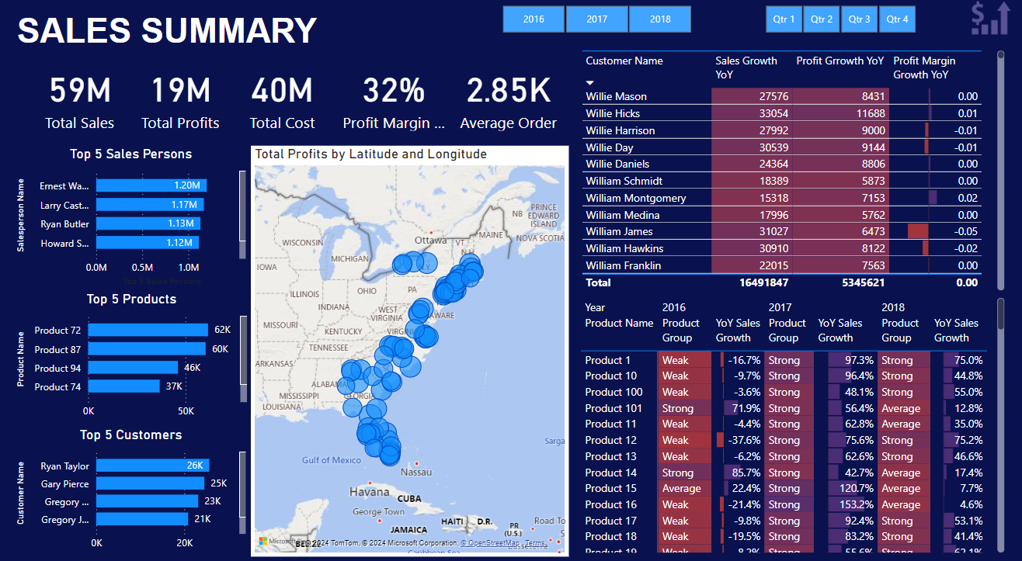
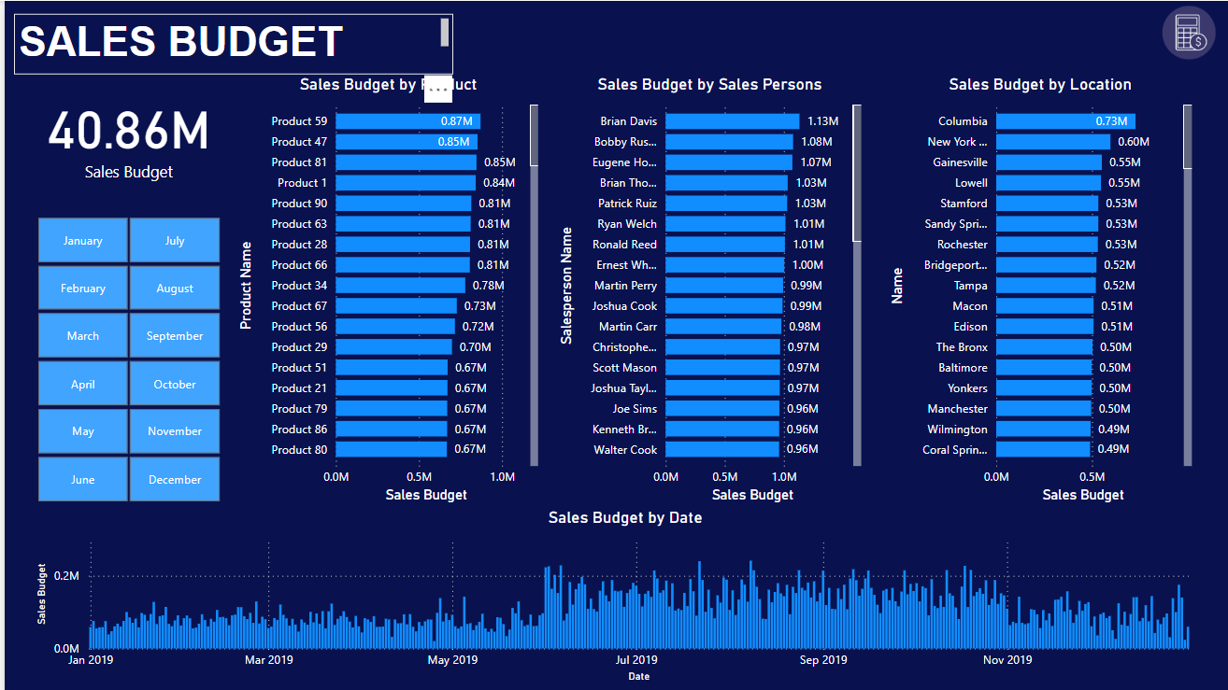

Slide 12
Sales Budget
Overall Sales Budget:
The total sales budget for the year is 40.86M.
Sales Budget by Product:
Product 59 has the highest sales budget at 0.87M, followed closely by Product 47 at 0.85M.
Several other products like Product 81, Product 1, and Product 90 are in the top range with budgets around 0.85M and 0.81M.
Sales Budget by Salesperson:
Brian Davis leads with a budget of 1.13M, followed by Bobby Russell (1.08M) and Eugene Holmes (1.07M).
Several other salespersons, including Brian Thomas and Patrick Ruiz, have budgets close to 1M.
Sales Budget by Location:
The highest budgeted location is Columbia, with a 0.73M budget.
Other significant locations include New York City (0.60M), Gainesville and Lowell, both at 0.55M.
Sales Budget by Date:
The line graph shows fluctuations in the sales budget over time, with spikes occurring at regular intervals, especially around the middle and end of the year (mid-May and early November).

Slide 13
Sales Summary
Overall Sales Performance:
Total sales amount to 59M.
Total profits stand at 19M, with a total cost of 40M and an overall profit margin of 32%.
The average order value is 2.85K.
Top 5 Salespersons:
Ernest Walters leads with 1.20M in sales, followed by Larry Castillo (1.17M) and Ryan Butler (1.13M).
Howard Scott also performs well with 1.12M in sales.
Top 5 Products:
Product 72 is the best-selling product with 62K in sales, followed by Product 87 (60K) and Product 94 (46K).
Product 74 rounds out the top 5 with 37K in sales.
Top 5 Customers:
The top customer is Ryan Taylor, with 26K in sales, followed by Gary Pierce (25K) and Gregory Chan (23K).
Gregory Jackson is also among the top customers, with 21K in sales.
Sales Trends by Location:
The map visualization shows sales profits across locations, with concentrated activity in the eastern and southern United States.
Willie Mason, Willie Hicks, and Willie Harrison are among the top customers contributing to this performance.
Sales Growth by Customer:
Willie Mason leads with YoY (Year-on-Year) sales growth of 27.5K, followed by Willie Hicks (33K).
William James has notable YoY sales growth of 31K, though his profit margin growth declined slightly.

Slide 14
Key Insights
Top Products like Product 72 and Product 87 consistently drive high sales volumes, while Product 59 leads in budget allocation.
Salespersons such as Ernest Walters and Brian Davis are major contributors to sales success, requiring focused support to maintain their high performance.
Key Locations like Columbia and New York City drive a large portion of the sales budget, indicating strategic regions to focus on for future growth.
Customer Insights suggest that Ryan Taylor and Willie Mason are critical to overall performance, contributing both high sales and positive profit growth, making them top priorities for relationship management.

Slide 15
Marketing Department
The Marketing Department is responsible for driving the company's growth by effectively promoting our products and engaging with our target audience. Recently, we analyzed our budget allocation for a specific period, revealing that we allocated 53% of our total budget towards marketing initiatives. This strategic planning reflects our commitment to maximizing our reach and impact in the market.
However, our actual spending during this timeframe amounted to 47% of the total budget. This discrepancy indicates a prudent approach to budget management, allowing us to either underspend or reallocate resources based on performance metrics and evolving market conditions.
The insights gained from this analysis enable us to assess budget adherence and evaluate the effectiveness of our marketing strategies. By continuously monitoring and adjusting our financial resources in alignment with our marketing objectives, we aim to optimize results and drive sales growth for our products. This approach ensures that we remain agile and responsive to market demands while maintaining fiscal responsibility

Slide 16
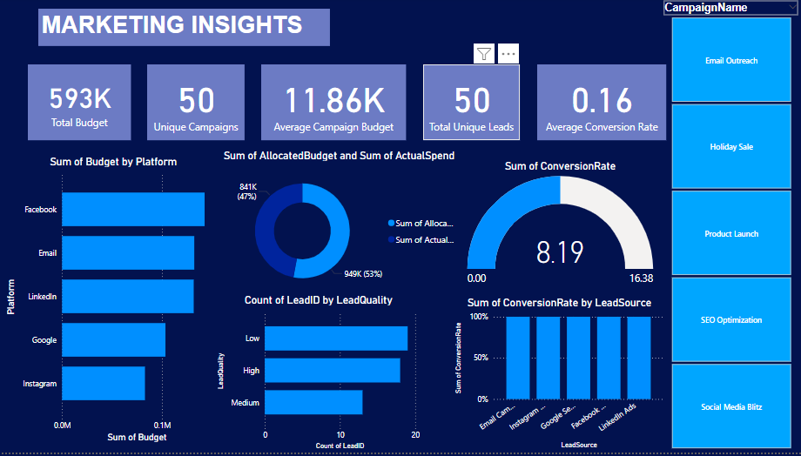

Slide 17
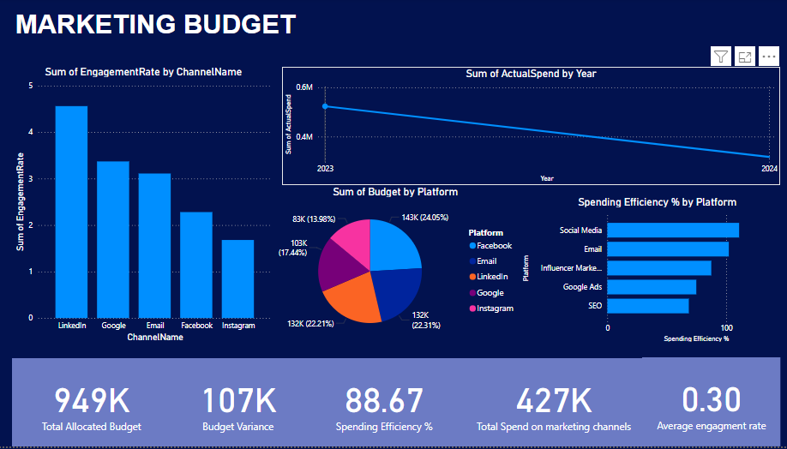

Slide 18
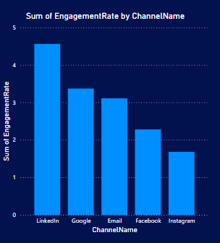
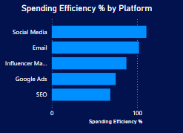
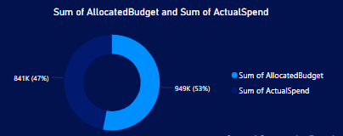
This diagram illustrates the engagement rates across various marketing channels, highlighting the effectiveness of each in capturing audience attention. The data indicates that LinkedIn leads with the highest engagement rate, showcasing its strength as a platform for professional networking. Following LinkedIn, Google ranks second, Email marketing comes in third. This comparative analysis underscores the importance of channel selection in optimizing marketing strategies for maximum engagement
This diagram compares spending efficiency across various marketing platforms in terms of return on investment (ROI). Social media platforms lead in efficiency, effectively engaging audiences and driving conversions. Email marketing follows closely, excelling in personalized outreach to target customers. Influencer marketing ranks next, highlighting its effectiveness in leveraging trusted voices. This analysis underscores the importance of choosing the right marketing platforms to optimize budget effectiveness and meet strategic goals.
This diagram illustrates a budget allocation of 53% for planned initiatives versus an actual spending of 47%. This difference suggests a strategic approach to budget management, indicating potential underspending or reallocation based on performance and market conditions. It serves as a tool for stakeholders to evaluate budget adherence, assess marketing effectiveness, and identify areas for future adjustments. Ultimately, it emphasizes the need to align financial resources with marketing goals to optimize results

Slide 19
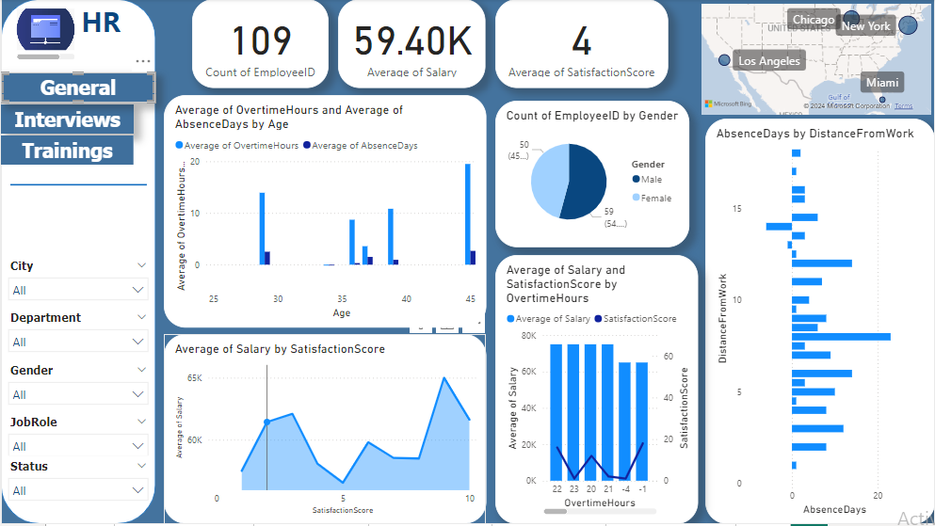
General HR Dashboard

Slide 20
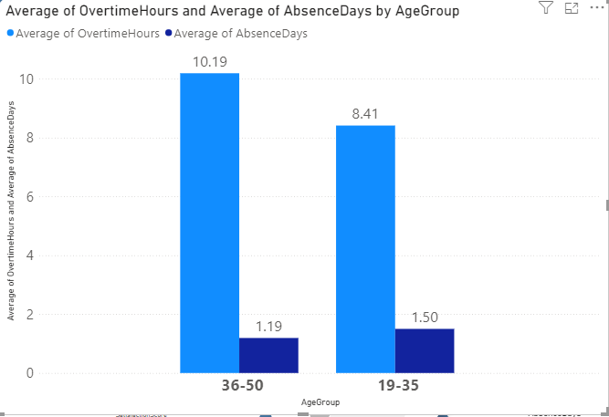
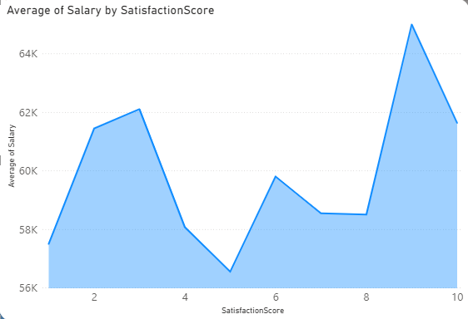
Overtime Hours and Absence Days by Age Insight: Younger employees (25-35) tend to work more overtime and take fewer absence days compared to older age groups (40+). This might indicate better work-life balance with age or differences in job roles.
Key Chart: Salary and Satisfaction by Overtime HoursInsight: Satisfaction drops for employees with higher overtime hours, especially for those working over 3 hours of overtime. This correlation between overtime and job satisfaction is critical to address.

Slide 21
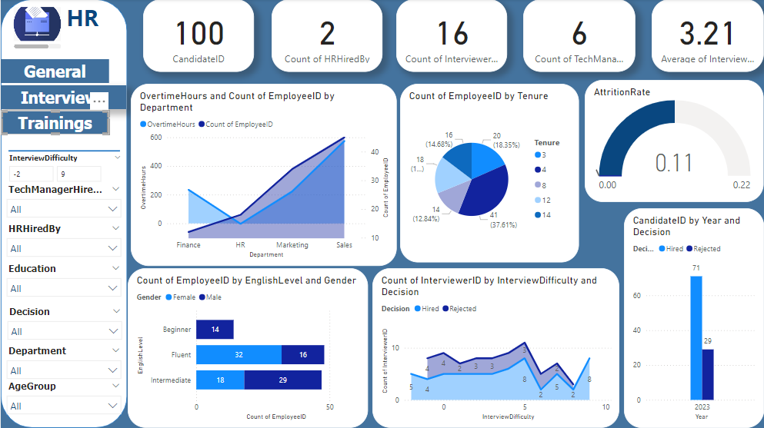
Interviews Dashboard

Slide 22
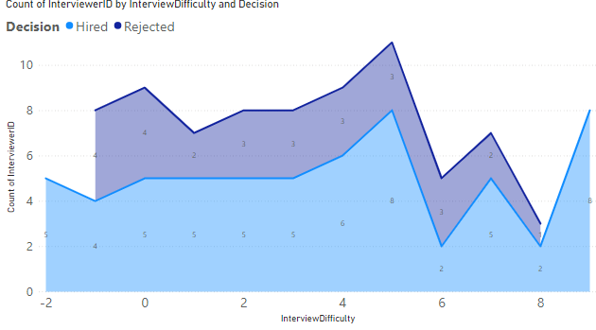
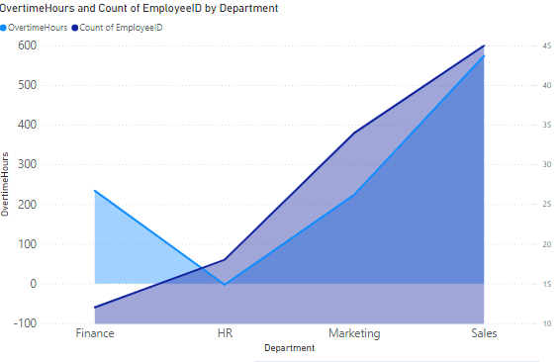
Key Chart: Interview Difficulty vs. Decision (Hired/Rejected)Insight: More candidates are rejected at higher interview difficulty levels, but there seems to be a threshold beyond which interview difficulty does not impact hiring (candidates with a difficulty score above 8 still get hired)..
Department-Specific Hiring Trends Insight: The Sales department shows the highest overtime hours, but also the highest number of hires. This may indicate that while the workload is demanding, candidates are being selected with the expectation that they can handle more overtime compared to other departments like HR and Marketing.

Slide 23
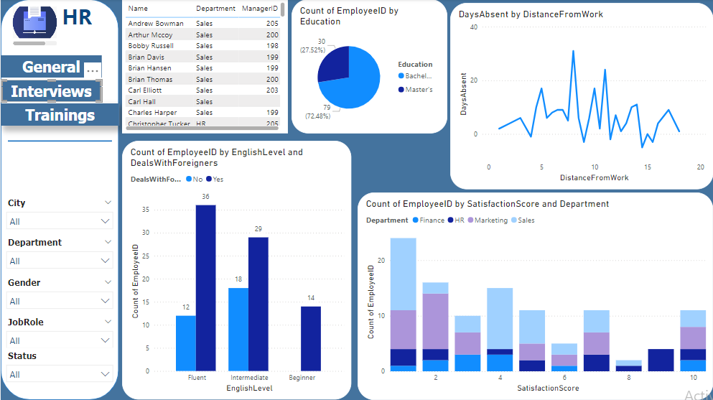
Training Dashboard

Slide 24
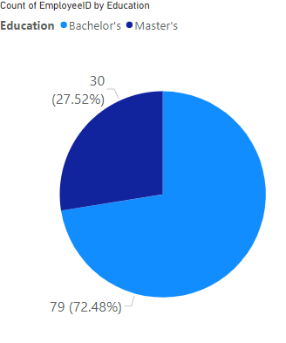
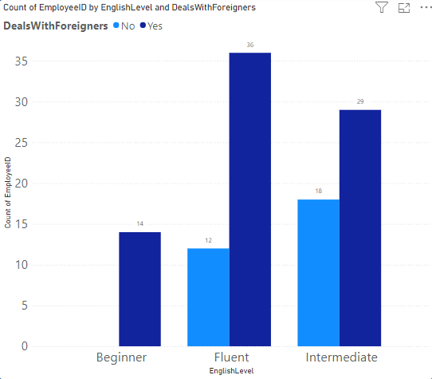
Key Chart: Education Level of Employees Insight: The majority of employees hold a Bachelor's degree, with only a small portion having a Master's. This might indicate potential areas for offering further education and training.
Key Chart: English Level vs. Deals with Foreigners Insight: Employees fluent in English are more likely to deal with foreign clients. This shows the importance of language proficiency in client-facing roles.

Slide 25

Ongoing Maintenance and Updates
Data Refresh
1
Schedule regular data refresh to ensure your visualizations are up-to-date with the latest information.
2
Dashboard Updates
Maintain and update dashboards as your data sources and reporting requirements evolve. Ensure visualizations are relevant and informative.
User Collaboration
3
Collaborate with users to understand their needs and tailor dashboards to their specific requirements.

Slide 26
Team Members
Jomana Hesham
Salma Ayman
Abdalla Mostafa Elshamy
Zainab Yasser Mohamed
Sama Medhat

